Slide 1
RESILIENT NORTHEASTERN NJ
VISION AND PRIORITIES
WAVE 1 MEETING IN A BOX
SPRING 2021

Slide 2
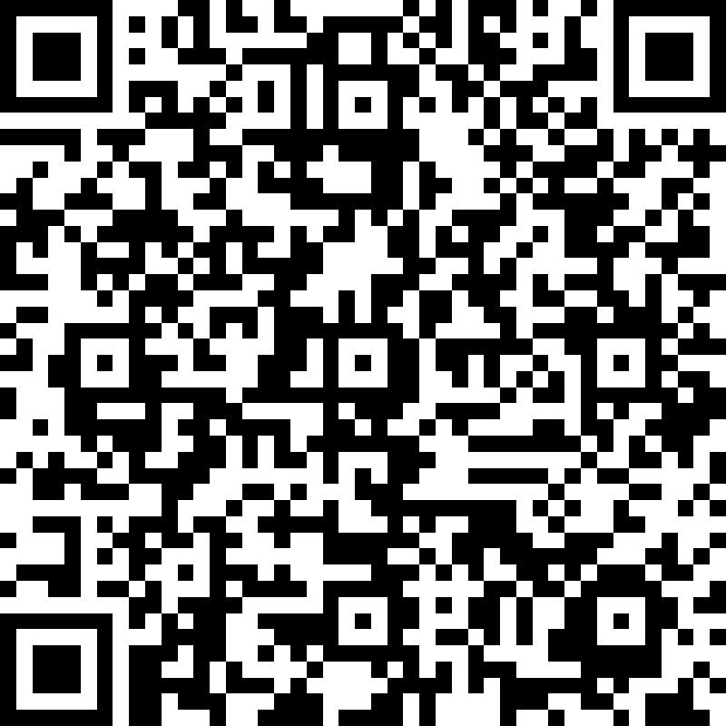
NOTES TO THE FACILITATOR
HIDE THIS SLIDE WHEN PRESENTING BY RIGHT CLICKING ON THE SLIDE IN THE PANEL AND SELECTING “HIDE SLIDE” (or delete it)
First, thank you so much for helping to ensure there is widespread public involvement in this important project!
We have included a sample script in the speakers notes of the PowerPoint file.
We recommend that one person presents this slide deck, while another takes notes either directly in the form accessible through the QR code to the right or separately such that it can be later logged as feedback via the QR code to the right.
This deck is intended to help support and guide your conversations to obtain the input needed at this phase of the project, but it is not intended to be prescriptive, nor is its use required. The important messages the project team hopes you will share are:
We are early in the project; information will evolve as we learn more through engagement and technical analysis
The project will consider all types of flooding
Right now, we are in the phase of understanding the community’s vision for the future and how flooding currently affects people’s lives. The types of feedback questions we are asking right now are pretty general, and they will get more specific as the project progresses
It can be helpful at the beginning of meetings with people new to you to set ground rules to help guide the meeting. Example possible ground rules include: Participate fully, give everyone the chance to speak, seek first to understand then be understood, respect the group’s time.
Please share your thoughts about what worked and didn’t work about the meeting, and how our next rounds of materials can be even better in the feedback form.
PLEASE LOG FEEDBACK FROM THE MEETING HERE

Slide 3
TODAY’S DISCUSSION
What we will share:
Project overview
Where the project is today
Flood hazard types the project will address
Ways to get involved
Thank you!
What we hope you will share:
If / how flooding has affected your life and community
What you love in your community
What changes you want to see in your community
How participating can be made easier for you
Anything else you would like to share
Notes:
The goal of today’s meeting is to share information about the Resilient Northeastern NJ project, its goals, and schedule, and to have discussions about our vision and priorities for our communities. We’ll give a brief introduction to the types of flooding that this project aims to address and we’ll provide details on how you can stay involved in the project and provide your input. Today we’re hoping to hear from you about the things you want to see in your community. The project will work to shape your vision through the solutions it proposes to reduce flooding. Feedback from today’s meeting will be sent straight to the project team and will be worked into the project’s findings.

Slide 4
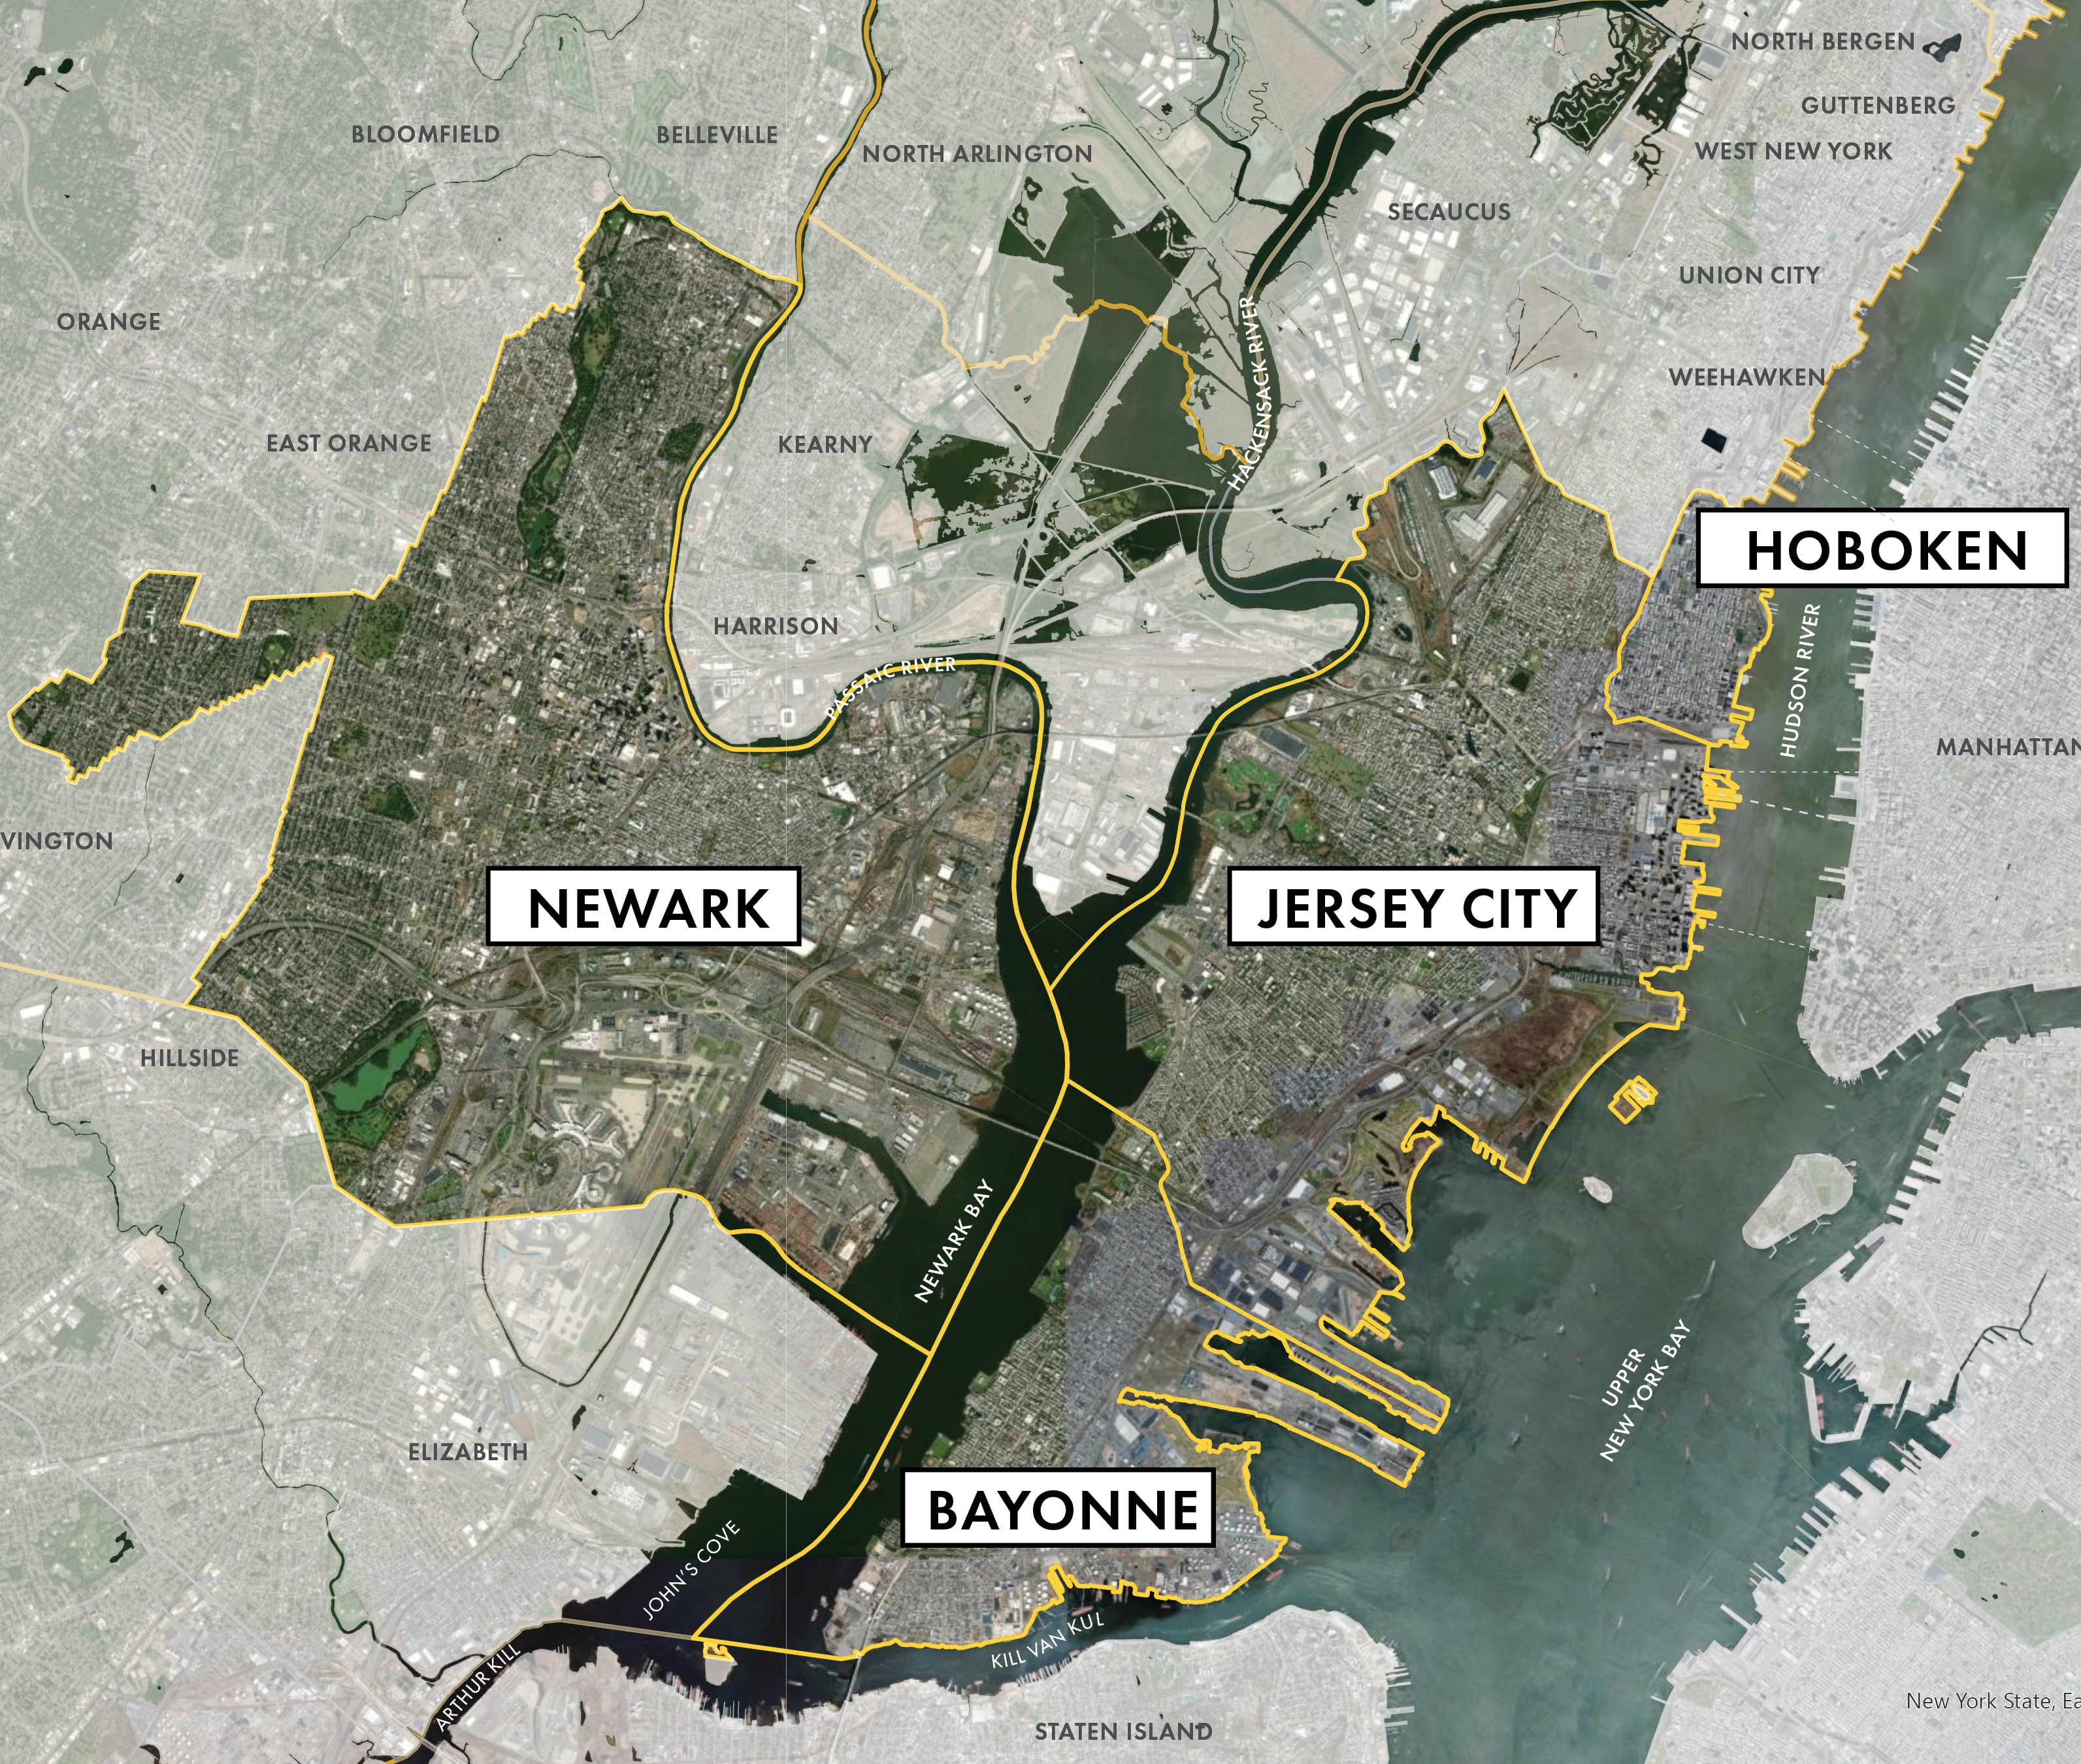
PROJECT OVERVIEW
NORTHEASTERN NEW JERSEY
Resilient Northeastern New Jersey is a partnership between Jersey City, Newark, Hoboken, Bayonne, Hudson County, and the community-based organizations of Ironbound Community Corporation and HOPES CAP. Representatives of these entities sit on the project’s Steering Committee.
The project is funded and administered through the New Jersey Department of Environmental Protection (NJDEP)
The project is focused on developing a regional action plan to address flood-related hazards.
Input from the people who live, work, and play in the region, and collaboration with a Community Advisory Council, will be critical to the success of the program.
Resilient Northeastern NJ Project Area
Image credit: City of Hoboken
Notes:
Key messages:
This project in Jersey City, Newark, Hoboken, and Bayonne is one of four regions in which this program is being administered.
The project is a partnership between the cities, Hudson County, and two community based organizations. This regional collaboration sets the project apart from many other past or ongoing initiatives related to flooding in this area.
The outcome of the project will be a regional action plan that identifies steps to address current and future flood risks
Other info:
The three other regions are Raritan River and Bay Communities, Long Beach Island, and Atlantic County Coastal Region.

Slide 5
WHAT IS RESILIENCE?
Resilience is the ability to adapt to changing conditions and grow in the face of challenges. In the context of flooding, we mean shaping communities that have strong social fabrics and infrastructure that can bounce back after storms.
Notes:
This is the definition of resilience being used for the project.

Slide 6
PROJECT GOALS
NORTHEASTERN NEW JERSEY
Build off ongoing resilience planning within the region
Ensure representation and participation from the communities that could be affected
Develop solutions that increase resilience in both the short- and long-term
Enhance ecological, recreational, and economic resources in the region
Ensure collaboration among a wide variety of stakeholders
Notes:
The goals of the project are to:
Build off ongoing resilience planning – a lot of related work has already been done in the region. The project aims to build off of and advance the other work to avoid duplicating efforts.
Ensure representation and participation – the goal is for the project to reach everyone who could be impacted by current and future flooding, and build the plan based on your input.
Develop solutions – the plan is addressing long-term flood risks, but will include actions that can be done to address flooding that we already see today
Enhance resources – the primary goal of the plan is to address flooding, but solutions that do this will also have other benefits to the region’s habitats, recreation, and economy
Ensure collaboration – a lot of different stakeholders are affected by flooding in our region, and the goal is to foster collaboration between these groups that lasts beyond the scope of this plan

Slide 7
PROJECT SCHEDULE
Spring 2021
Summer 2021
Fall 2021
Winter 2021
Spring 2022
Develop a Regional Vision and Identify Shared Priorities
Analyze Risk and Evaluate Relevant Tools
Develop Resilience Scenarios based on Vision, Risks, and Tools
WE ARE HERE
Select a Preferred Scenario and Develop and Action Plan
Publish the
Phase 1
Final Plan for Implementation
Notes:
Public launch was in March of 2021. The final action plan is expected in May of 2022. The project is being managed in waves, and each wave will have a different set of questions for your feedback. This wave is focused on broad questions to set vision and priorities across the region. The project will also include a technical risk assessment of flood impacts. The risk assessment and feedback will inform development of multiple scenarios that include different sets of actions to address the flood risks. Based on your feedback, a preferred scenario will be selected for the final plan.

Slide 8
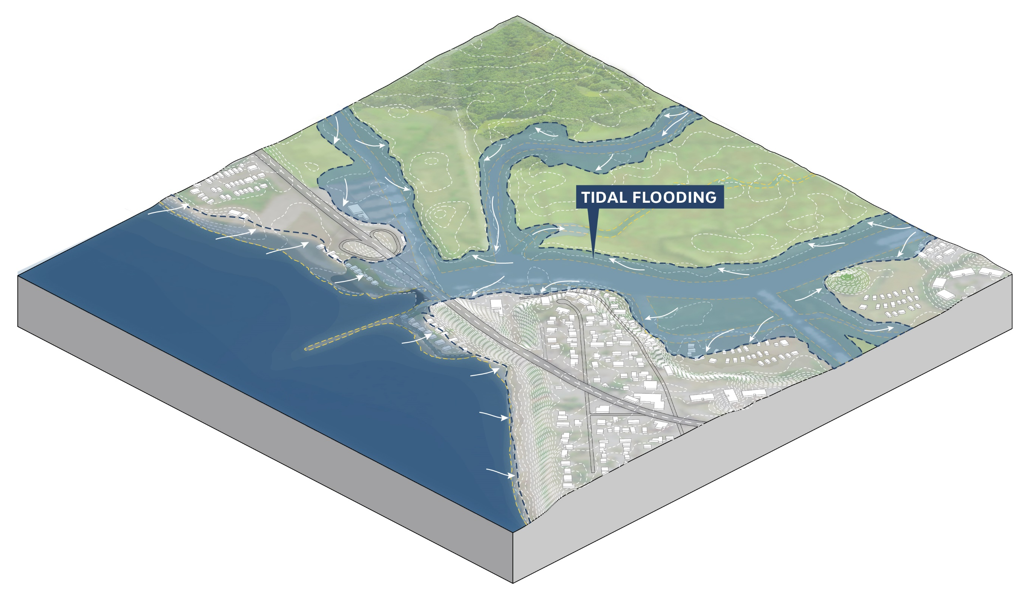
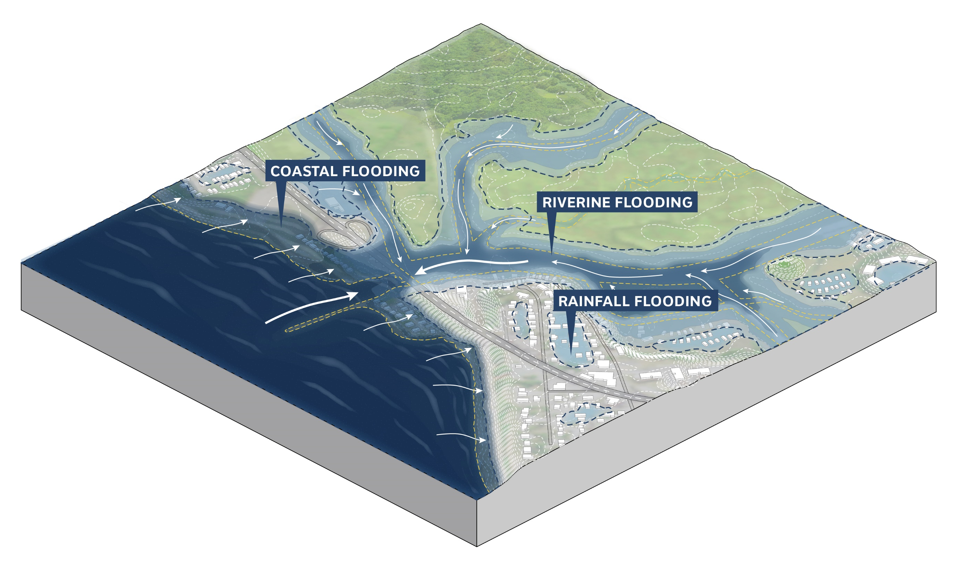
FLOOD HAZARD TYPES THE PROJECT WILL COVER
CONDITIONS
CURRENT (YEAR 2000)
2.4 FEET OF SEA LEVEL RISE + 10% INCREASE IN PRECIPITATION (~YEAR 2070)
TIDAL FLOODING
STORM-RELATED FLOODING
Notes:
The flood data that will be used is different from FEMA flood maps and likely other maps you’ve seen before. Not only will the project be looking at storm related flooding, but it will also look at potential tidal flooding with sea level rise. Tidal flooding refers to sunny day flooding that might happen without a storm.
The storm related flooding will include heavy precipitation and urban flooding, which are not often seen on FEMA flood maps, in addition to costal flooding from storms. The flood models for this project are still in development, but will be available soon, and the hope is that they will help fill in gaps often left by other federal modeling efforts, which tend to focus on coastal and riverine flooding, and less cover flooding from heavy precipitation. The project is looking at sea level rise and changes in rainfall now and through 2070.

Slide 9
QUESTIONS FOR DISCUSSION
What do you value most about your community?
Notes:
Note to organizer: Please take notes on responses to these questions during the meeting in this form: https://forms.office.com/Pages/ResponsePage.aspx?id=fQWQf6A-_kawfOBWhicIGydkR2m1Br5OhSCcWjY8Kp5UNFI2Szc3QlE2RFlZTEZCNFZZWDZTWUVPRyQlQCN0PWcu. NOTE: the form has a 4,000 character limit for long answers. If you need more space, feel free to submit a second form with continuation of responses.

Slide 10
QUESTIONS FOR DISCUSSION
What changes do you want to see for yourself and future generations?
Notes:
Note to organizer: Please take notes on responses to these questions during the meeting in this form: https://forms.office.com/Pages/ResponsePage.aspx?id=fQWQf6A-_kawfOBWhicIGydkR2m1Br5OhSCcWjY8Kp5UNFI2Szc3QlE2RFlZTEZCNFZZWDZTWUVPRyQlQCN0PWcu. NOTE: the form has a 4,000 character limit for long answers. If you need more space, feel free to submit a second form with continuation of responses.

Slide 11
QUESTIONS FOR DISCUSSION
Where / how do you currently experience flooding?
How does flooding affect your life and community?
Notes:
Note to organizer: Please take notes on responses to these questions during the meeting in this form: https://forms.office.com/Pages/ResponsePage.aspx?id=fQWQf6A-_kawfOBWhicIGydkR2m1Br5OhSCcWjY8Kp5UNFI2Szc3QlE2RFlZTEZCNFZZWDZTWUVPRyQlQCN0PWcu. NOTE: the form has a 4,000 character limit for long answers. If you need more space, feel free to submit a second form with continuation of responses.

Slide 12
QUESTIONS FOR DISCUSSION
What is the most important factor to consider when choosing actions that could reduce flood risk in your community?
Notes:
Note to organizer: Please take notes on responses to these questions during the meeting in this form: https://forms.office.com/Pages/ResponsePage.aspx?id=fQWQf6A-_kawfOBWhicIGydkR2m1Br5OhSCcWjY8Kp5UNFI2Szc3QlE2RFlZTEZCNFZZWDZTWUVPRyQlQCN0PWcu. NOTE: the form has a 4,000 character limit for long answers. If you need more space, feel free to submit a second form with continuation of responses.

Slide 13
GET INVOLVED!

Slide 14
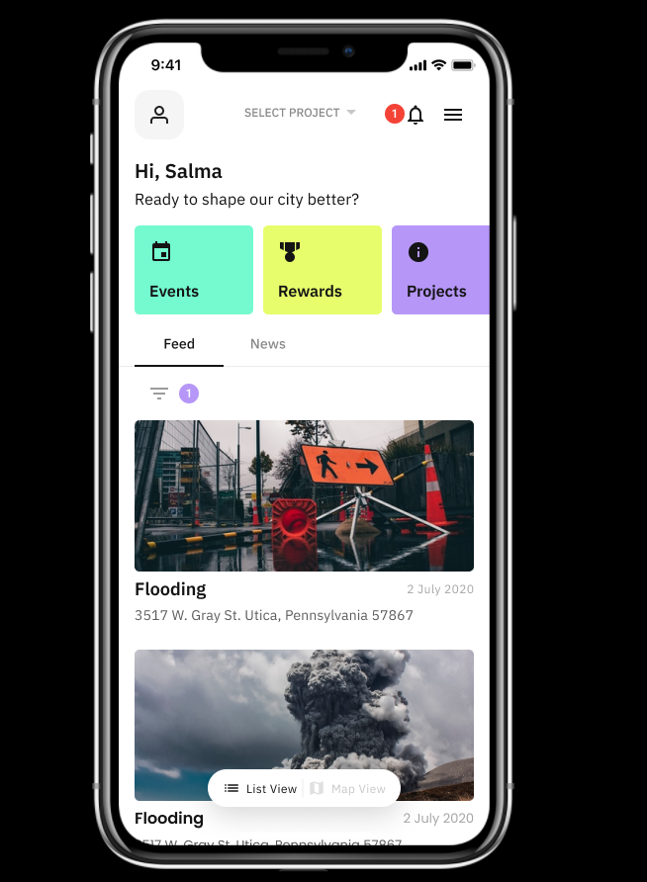
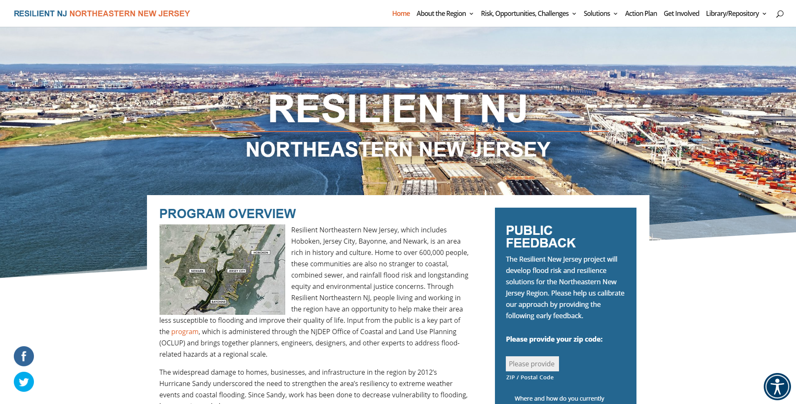
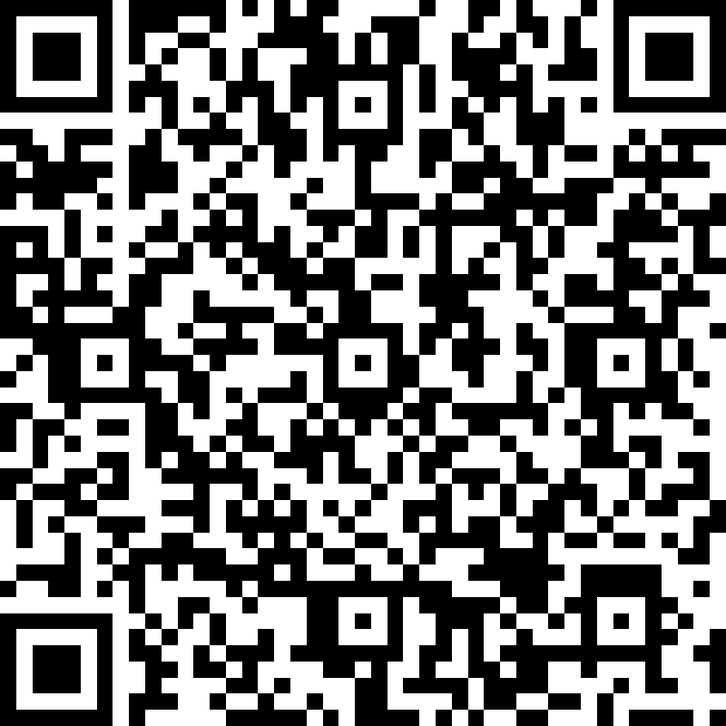
ANYTIME ENGAGEMENT OPPORTUNITIES
Share your artwork!
Download the IRYS APP
Share thoughts through the website: www.resilient.nj.gov/nenj
Complete the spring survey: https://tinyurl.com/RNJ-NENJ-Vision-Survey
Share thoughts to the project hotline
Engage on social media
@ResilientNENJ (twitter / FB)
@Resilient_NENJ (Instagram)
Share thoughts by email
ResilientNENJ@dep.nj.gov
201-275-0861
English, Spanish, Portuguese, Arabic, Hindi, Polish
Notes:
Now we will talk about ways to get involved in the project and share your feedback. These engagement opportunities will be available throughout the project, but the content and questions will change as the project progresses.
Irys app: available in App Store and Google Play Store. Through the app, you can share location-based feedback on things you love, want to see change, or locations of flooding; receive project updates; and respond to surveys.
Survey: Use the QR code shared. Questions are about things you love about your community, things you want to see change, and how you are impacted by flooding
Artwork: we can share the materials. Create a drawing, sketch, or photo and share through social media!
Hotline: Similar questions to the survey

Slide 15
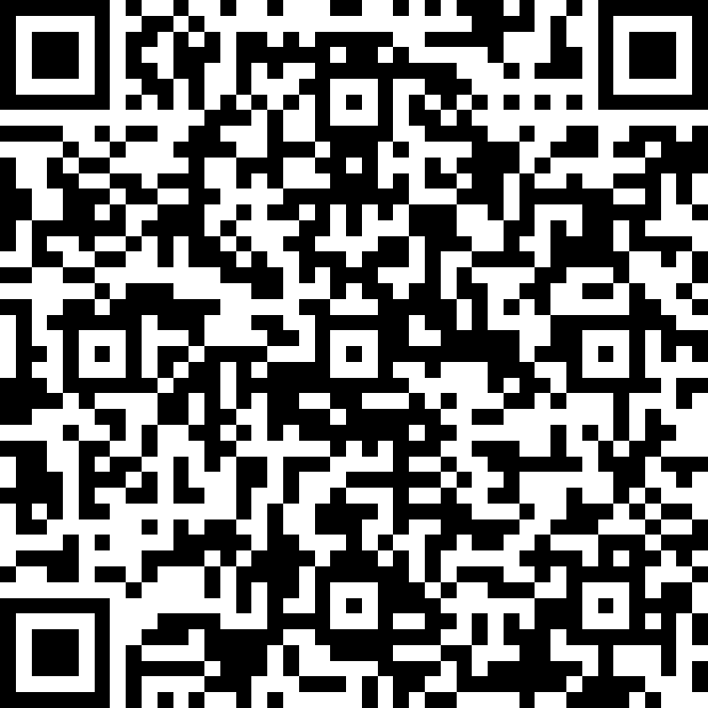
OTHER WAYS TO GET INVOLVED
Public input is vital to ensuring that the resilience action plan will help advance our communities’ goals and priorities. Here are a few of the ways that you can get more involved in the program:
FUTURE MEETINGS
Meeting content will change throughout the project. Visit the website often for the latest RNJ information.
Sign up using the QR code below to get project updates via email
FUTURE SURVEYS
Survey questions will be updated for each project wave. Visit the website to see our latest surveys. Your valuable input will help achieve the goal of minimizing flooding in our community.
INTERVIEW YOUR FAMILY, FRIENDS, AND COWORKERS
Share the results with the project team using the QR code below.
CONDUCT YOUR OWN MEETING
Have a dinner at your home, meet with friends at a park, or hold a Zoom call. Use this deck, available on our website, or don’t! Talk about Resilient NJ and share the feedback from your meeting to the project team at this QR code.
Notes:
These are some other ways that you will have opportunities to get involved as the project progresses.

Slide 16
QUESTIONS FOR DISCUSSION
This is the beginning of the process.
What value do you hope to get out of this process? How can the project team make participating easy and valuable?
Notes:
Note to organizer: Please take notes on responses to these questions during the meeting in this form: https://forms.office.com/Pages/ResponsePage.aspx?id=fQWQf6A-_kawfOBWhicIGydkR2m1Br5OhSCcWjY8Kp5UNFI2Szc3QlE2RFlZTEZCNFZZWDZTWUVPRyQlQCN0PWcu. NOTE: the form has a 4,000 character limit for long answers. If you need more space, feel free to submit a second form with continuation of responses.

Slide 17
THANK YOU!

Slide 18
^{REGION TEAM}
^{JERSEY CITY}
^{NEWARK}
^{HOBOKEN}
^{BAYONNE}
^{HUDSON COUNTY}
IRONBOUND COMMUNITY CORPORATION
^{HOPES CAP, INC.}
^{CONSULTANTS}
^{ARCADIS}
^{INGROUP, INC.}
^{SCAPE LANDSCAPE ARCHITECTURE}
^{ONE ARCHITECTURE & URBANISM}
^{IRYS}
^{SAM SCHWARTZ ENGINEERING}
^{HEYER, GRUEL & ASSOCIATES}

